Slide 1
BPES Group E Parent Orientation
February 24, 2021

Slide 2
Agenda
Schedules
School Hours, Transportation, Arrival & Dismissal
Breakfast, Lunch, Recess
A Day in the Life of a Group E Student
Health & Safety
Q & A

Slide 3
HCPSS Elementary Return Timeline
March 1, 2021 - Group E (Everyday) students return in-person
Week of March 15, 2021 - Hybrid students in Pre-K-2nd grades return in-person
Week of March 29, 2021 - Hybrid students in 3rd-5th grades return in-person

Slide 4
School Hours
RECC - Monday/Tuesday/Thursday/Friday
AM Students (Preschool): 9:40am-12:10pm
PM Students (Prekindergarten): 1:40pm-4:10pm
MINC-EL Peers: 9:40-12:00pm
MINC-EL Full day students: 9:40am-4:10pm
Kindergarten-5th Grades
Mon/Tues/Thurs/Fri: 9:40am-4:10pm
Wednesday: 9:40am-12:10pm

Slide 5
What Will My Child Do on Wednesdays?
On Wednesdays, students in Group E will receive in person learning supports from 9:40-12:10. Students will have support time with their homeroom teacher and their mathematics teacher. Students receiving additional IEP/504/EL/reading support services may also receive services during this time.
Group E students will be able to take Grab & Go lunch at dismissal to take home with them - they will not eat lunch at school.
Note: RECC students do NOT attend school on Wednesdays.

Slide 6
Bus Information
Bus stop location, pickup and drop off times will be available on the HCPSS website
http://www.infofinderi.com/ifi/?cid=HCP2IOASIJVW
Families of students who receive specialized transportation will be contacted by bus contractors
Assigned seats, one per seat (unless siblings)
Attendance taken daily
Bus will load rear to front and unload front to rear
Masks required - disposable masks will be available
Windows will be down - please dress your child accordingly

Slide 7
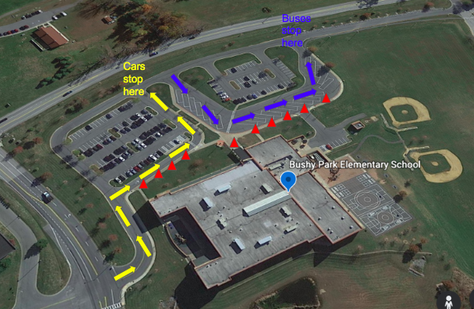
Arrival & Dismissal
Staff outside at 9:30 - Please do not drop students off before this time
Staff in car loop will assist students getting out of the car - please do not get out of your car
Staggered dismissal
RECC car riders will meet on the RECC playground for both arrival and dismissal

Slide 8
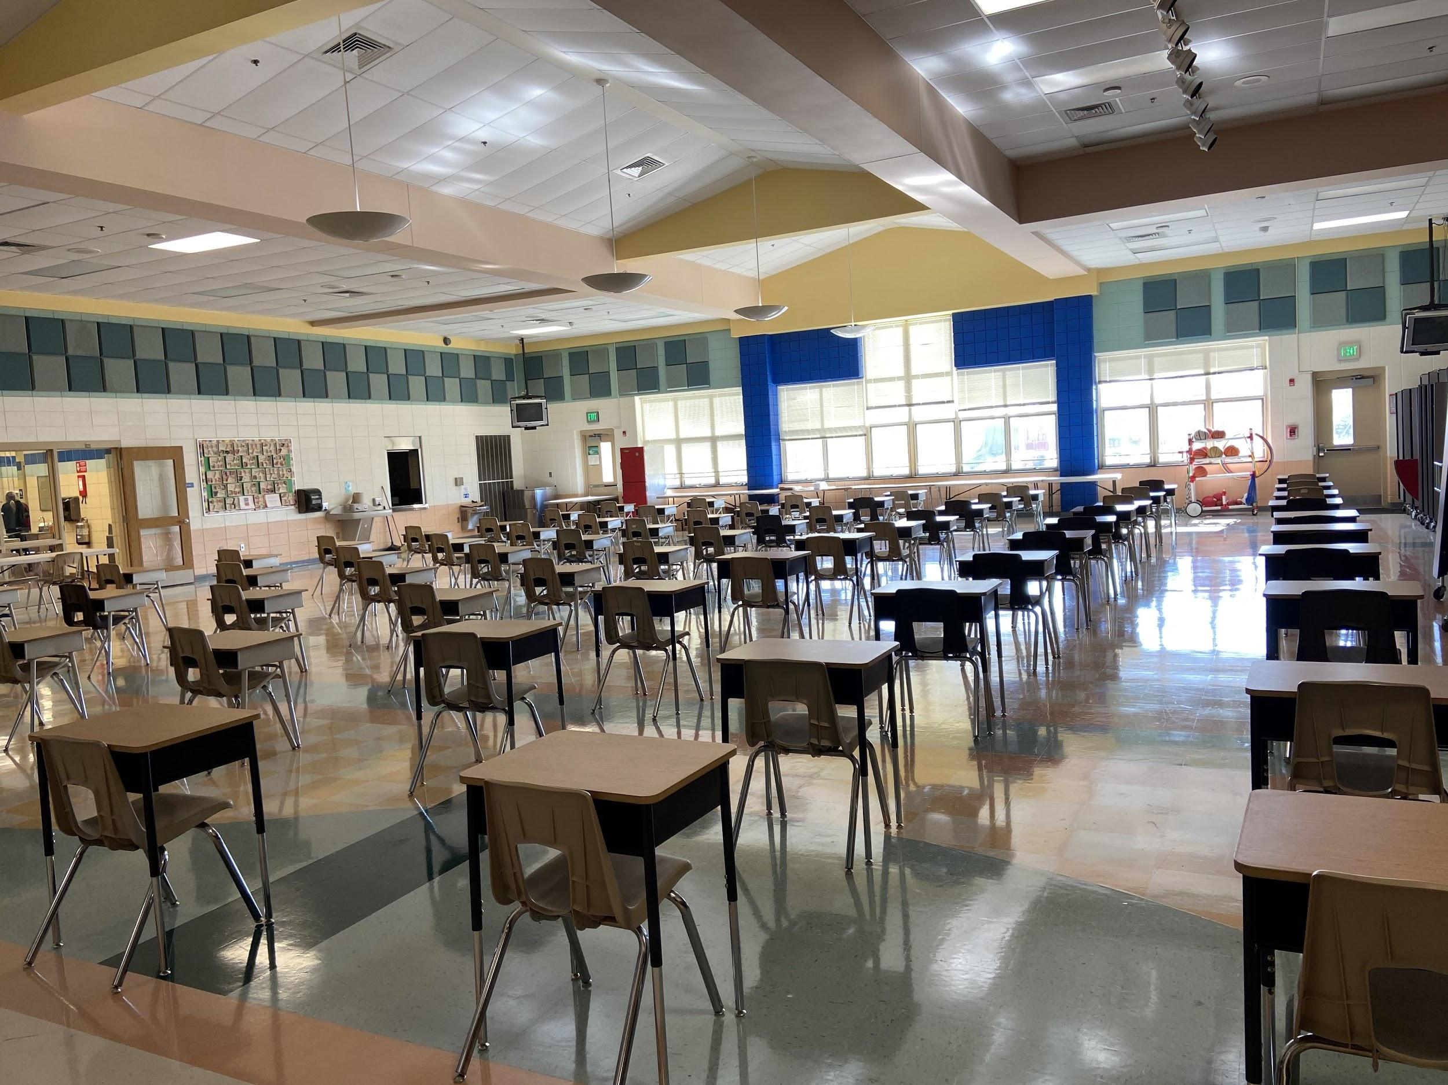
Breakfast and Lunch
Free Grab & Go Breakfast for all students
Free lunch for all students
Lunch will be Grab & Go on Wednesdays (K-5)
RECC students will also have the opportunity to receive meals
Socially-distanced cafeteria seating
Masks on while not eating
Sanitizer in cafeteria

Slide 9
Recess
Outside weather permitting - please dress appropriately
Students will be assigned zones (field, playground, blacktop)
Playground equipment will be used
Examples of contactless games:
Red light/green light
Yoga
Scavenger hunts
Students will be masked at recess and social distancing will be expected
Hand sanitizer will be encouraged before, during, and after recess
Indoor recess - students will be supervised indoors - no shared games or materials

Slide 10
A Day in the Life of a Group E Student
What to bring - Please label everything with permanent marker:
Fully charged Chromebook and charging cord
Headphones (non-bluetooth)
2 masks, in a plastic bag
Face shield (optional)
Water bottle
Student login information
Supply box and journals - Group E may leave at school
Lunch, if not taking school lunch
Snack, if requested by your child’s teacher
Art supply bag

Slide 11
A Day in the Life of a Group E Student
How to prepare the art supply bag:
Sharpened pencil, large eraser, sharpie, sharpened colored pencils, markers, crayons, glue and scissors (please leave watercolor sets at home)
Art folder (will be distributed next week) with folded 12x18 drawing paper (provided in August)

Slide 12
A Day in the Life of a Group E Student
Since Group E students are returning to the building in advance of the hybrid groups, class sizes will be quite small during the first two weeks of school. It is possible that some classrooms may have only one student for the first two weeks and on some Wednesdays during the school year.
During the first 2 weeks (or more), the remainder of the class will participate concurrently via Google Meet. A student attending in-person may log in to the Google Meet to join their virtual classmates.

Slide 13
Transitions
Students will transition to math, related arts, and other classes, including special services, as well as lunch and recess
Social distancing marks and signage will be in all hallways and transition areas like the cafeteria, arrival areas, stairwells, and recess

Slide 14
In the Classroom...
Each student has 2 desks - for work space and personal items. Students will put their backpacks under the second desk.
Student chairs are at least 6 feet apart.
Hand sanitizer will be available.
Hand washing will be encouraged.
Masks required unless there is a medical accommodation.
Disinfectant wipes will be available.
The teacher will teach from his/her working area.

Slide 15
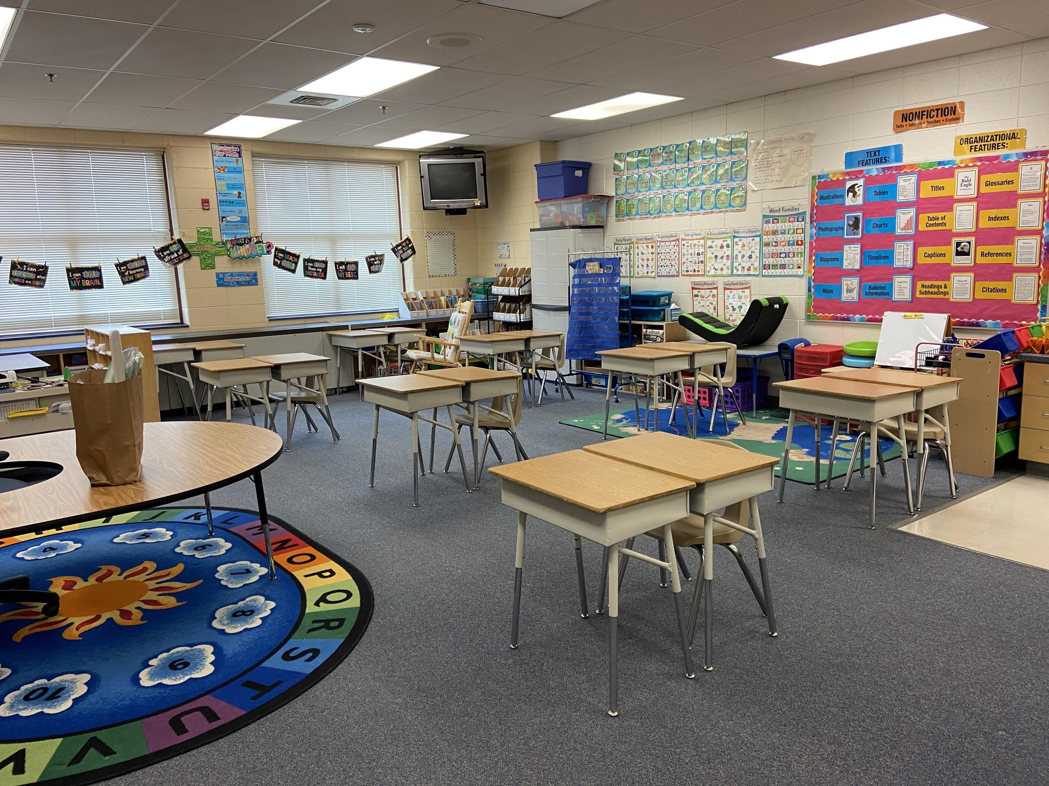
Classroom Setup Example

Slide 16
Related Arts
Students will transition to Related Arts classes
Virtual and in-person students will have the same lesson
Chromebooks may be used in all RA classes
No asynchronous assignments for related arts

Slide 17
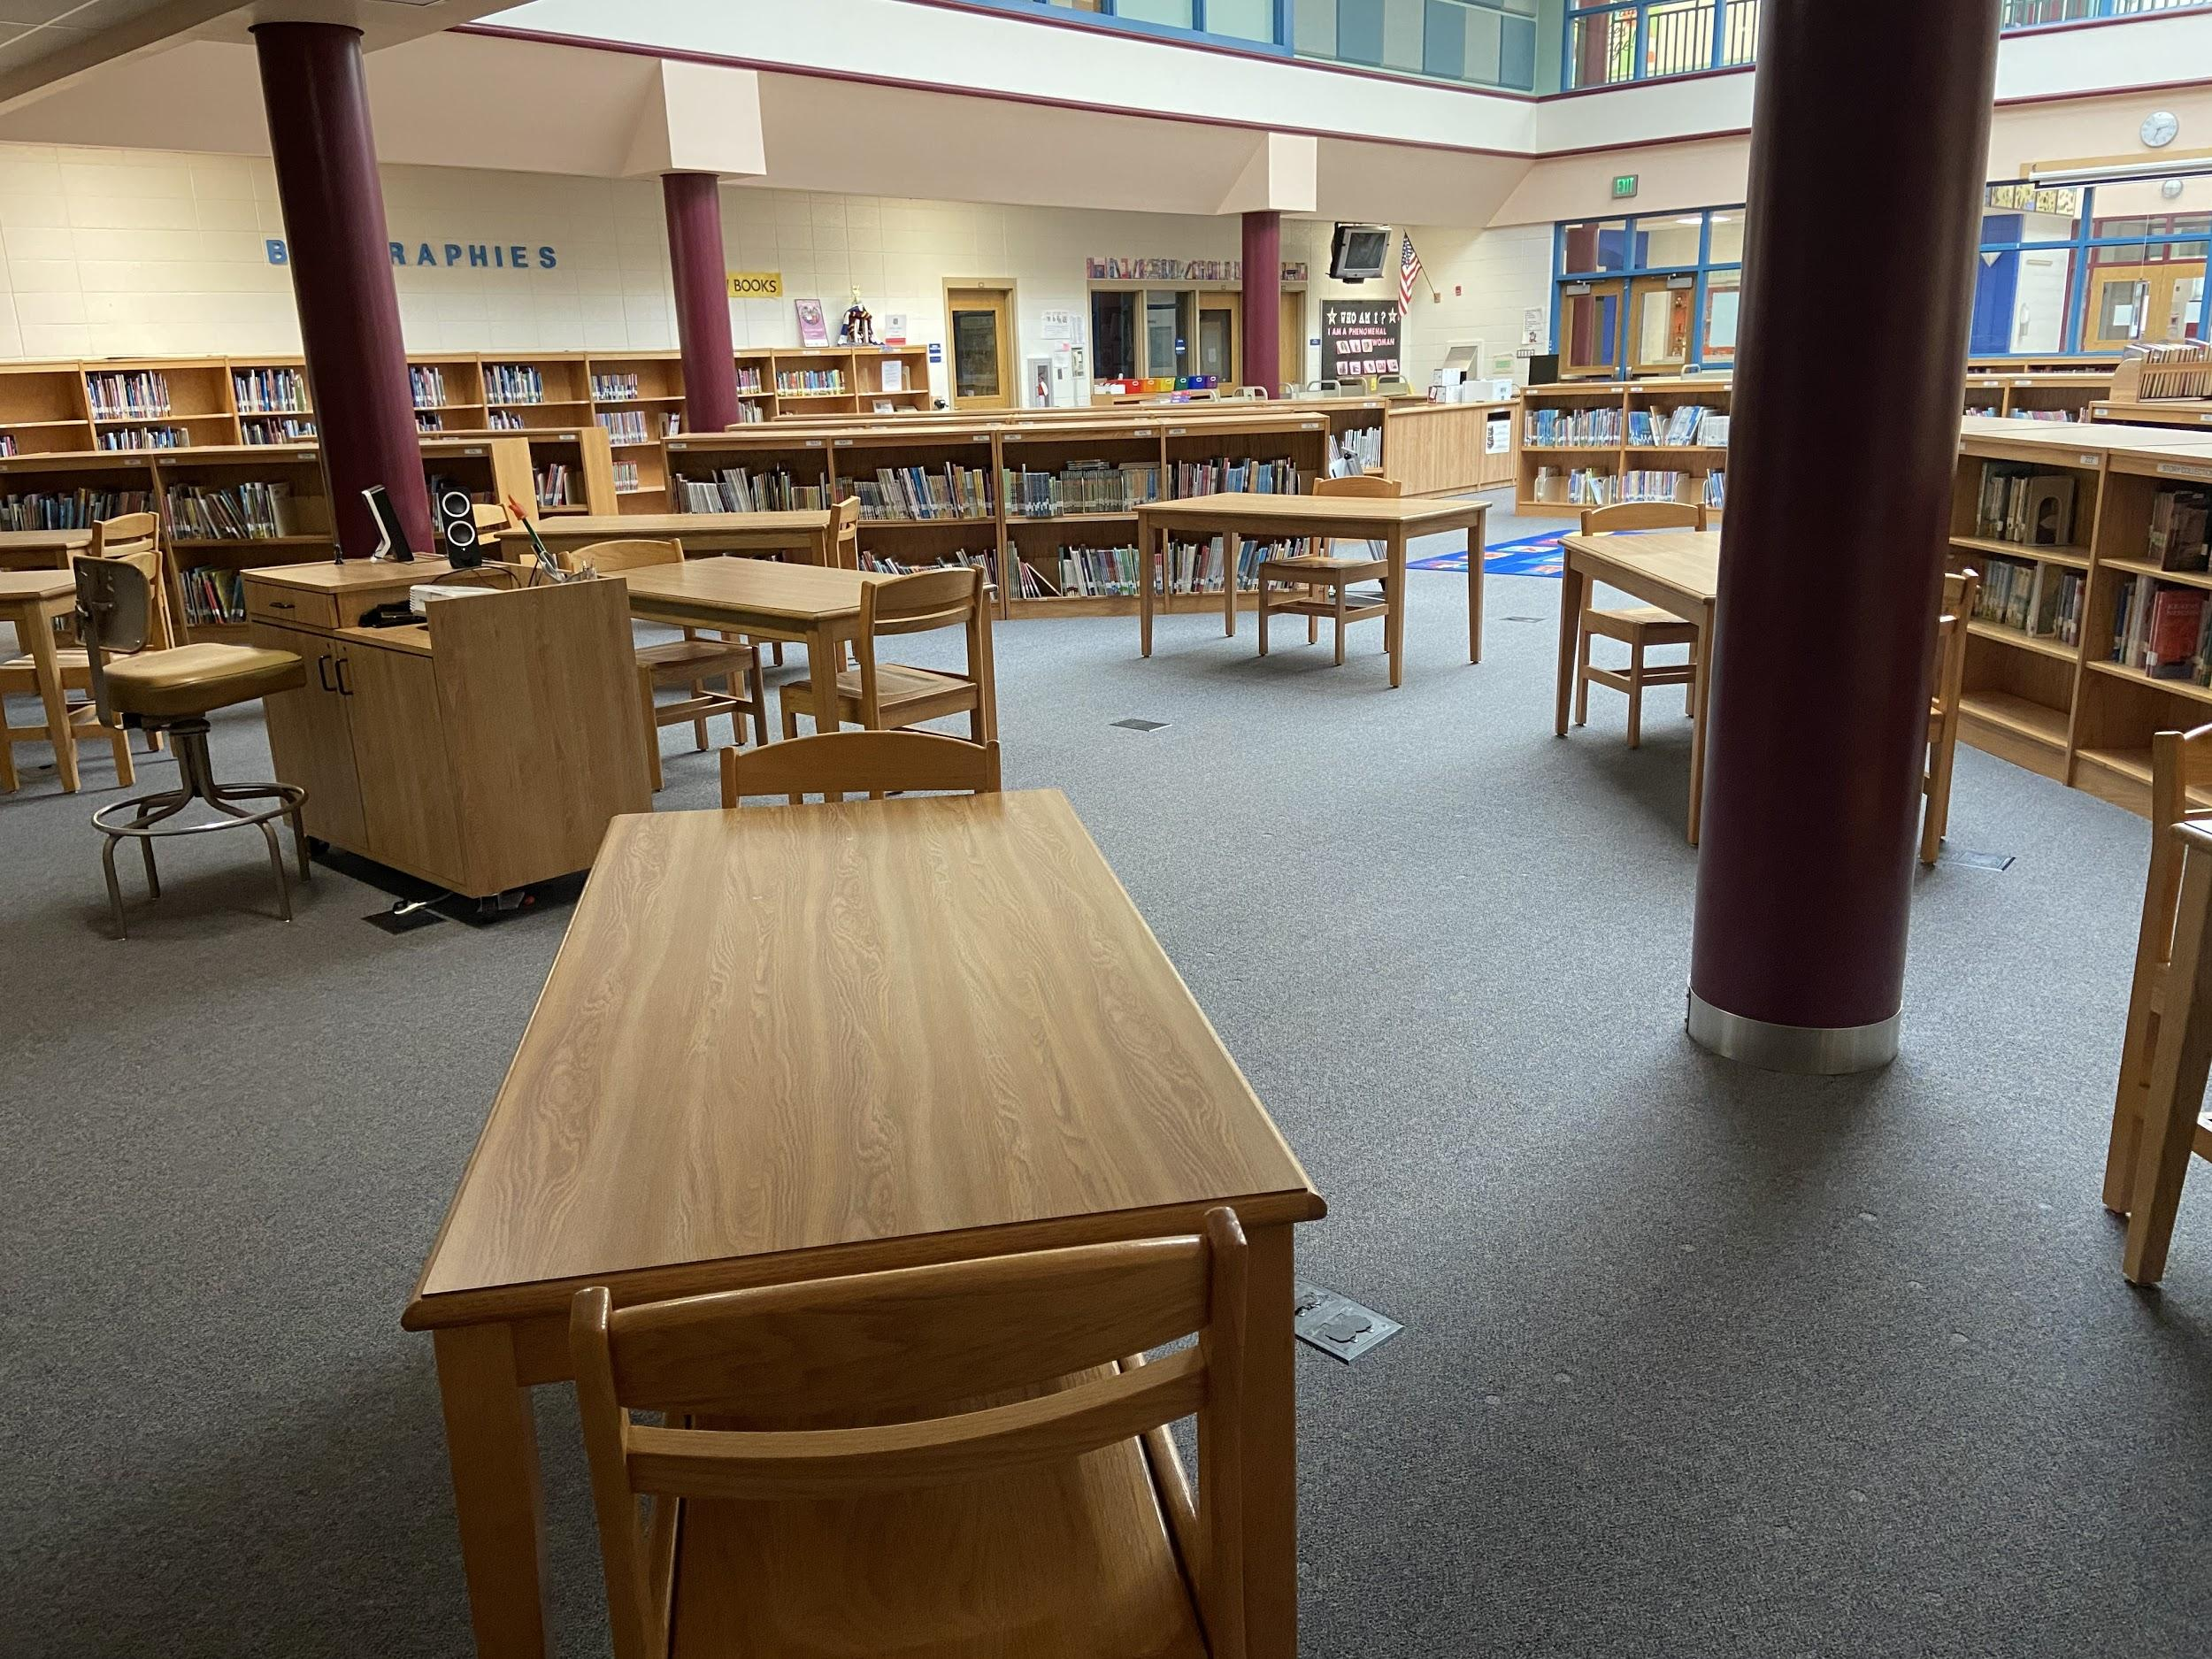
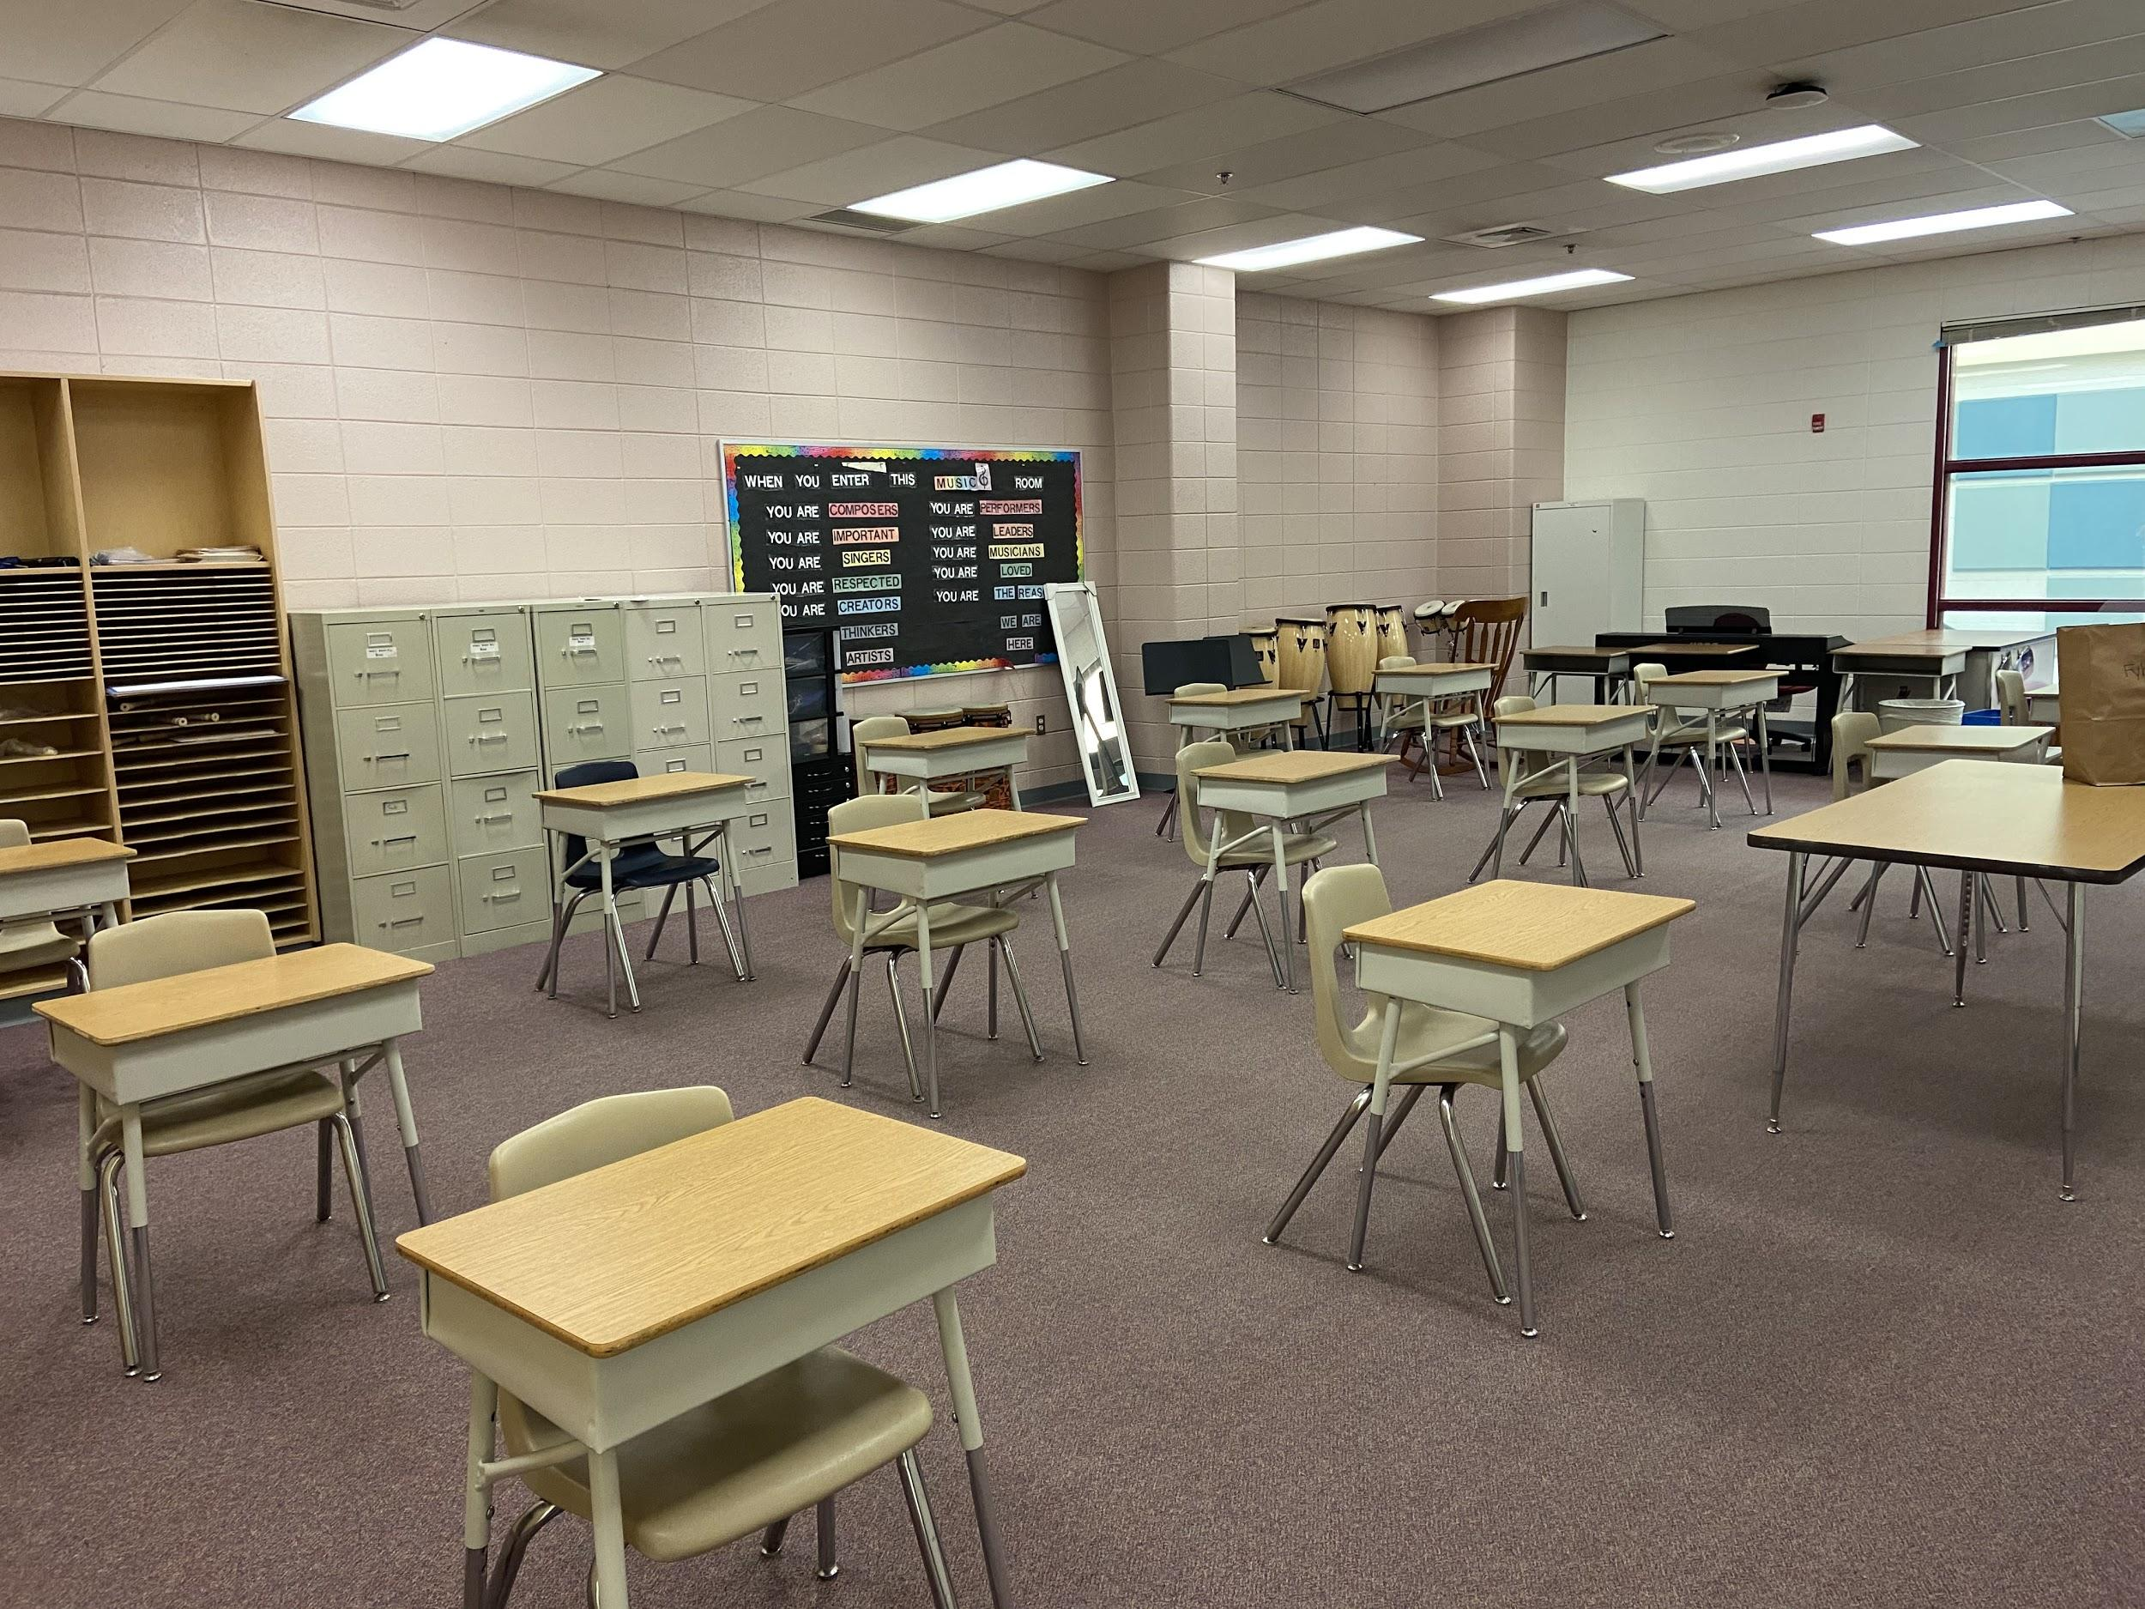
Related Arts Spaces

Slide 18
Health & Safety
Personal Protective Equipment (PPE)
Nitrile gloves for all staff
Reusable, 3-ply cotton face masks for all staff and students
Clear face masks to support individuals with hearing/speech needs
Supply of disposable masks for school use as needed
Hand sanitizer in every classroom and areas throughout the school
Desk shields and tabletop sneeze guards, where required
Face shields for all staff and students (optional to wear)
Disinfectant wipes
Extra facial tissues

Slide 19
Health & Safety
COVID & Contact Tracing:
A student determined to be a close contact with a person with verified COVID-19 must quarantine for 14 days. Identified close contacts of those with COVID-like illness will also be sent home and instructed to quarantine.
Students or staff who have tested positive for COVID-19 should isolate and not return to school until they have been out at least 10 days from the onset of symptoms or positive test without symptoms, remain fever-free for 24 hours, and show a consistent improvement of symptoms.

Slide 20
Health & Safety
Contact tracing is handled by the Howard County Health Department (HCHD), with support from and in coordination with the HCPSS Office of Health Services.
Contact our cluster nurse, Mrs. Denie Gorbey-Creese, with questions regarding COVID and contract tracing protocols.
Denie_Gorbey-Creese@hcpss.org

Slide 21
When Should My Child Stay Home?
New onset cough or shortness of breath
Fever over 100.0 or chills within the past 24 hours (without medication)
New loss of taste or smell
Fatigue
Muscle or body aches
Headache
Sore throat
Congestion or runny nose
Nausea or vomiting
Diarrhea

Slide 22
How Can I Help My Child Prepare?
Practice wearing masks for longer periods of time.
Practice standing 6 feet apart from others.
Practice frequent hand washing.
Practice INDEPENDENTLY opening and closing food containers, snack bags, yogurt, etc. so that only your child touches their own food without an adult assisting and touching it.
Practice tying shoelaces independently.
Practice logging in by themselves.
Review with them where they will go when they arrive in the morning.

Slide 23
Most of all...
Help your child prepare that school will not look or feel the same as they remember - this is our first step forward in a gradual return to our normalized environment. Our modeling will help shape their reactions.
Thank you for your help in supporting our return to in-person opportunities for your child!

Slide 24
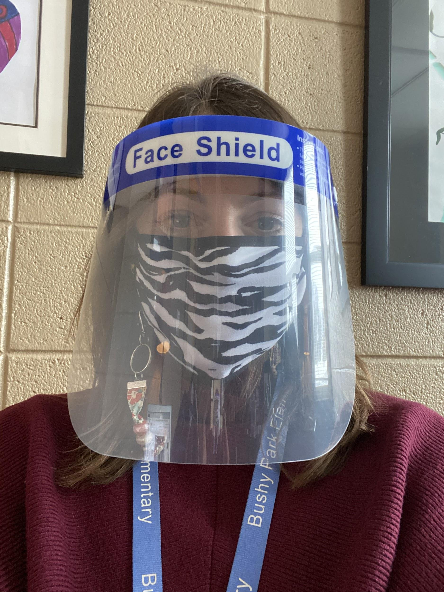
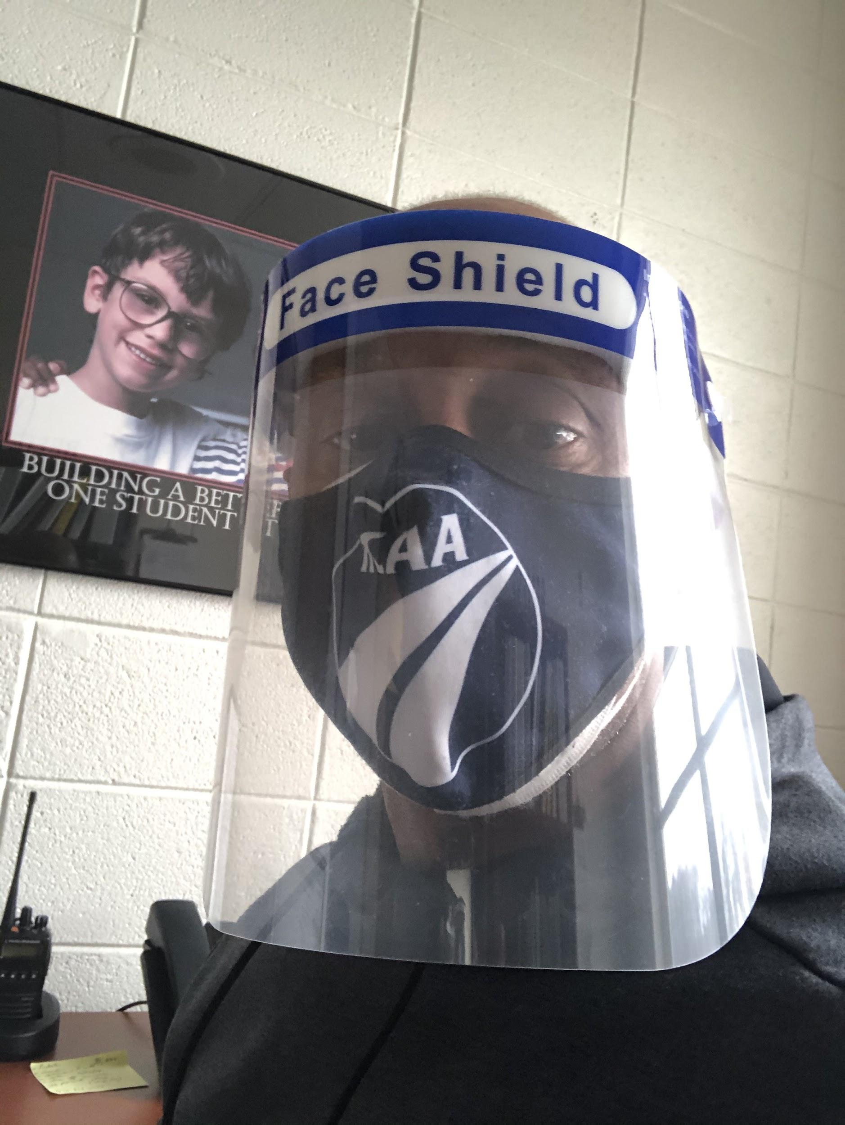
Questions?
Julia_Bialeski@hcpss.org
Charles_West@hcpss.org
BPES: 410-313-5500

